Slide 1
Chapter 1 From Zero to One (part 1)
Suffolk County Community College
CSE 222, Spring 2020

Slide 2
Topics:
Goals
Background
Managing Complexity
The Digital Abstraction
Von Neumann Architecture
Number Systems
Logic Gates (Combinational & Sequential Logic )
Logic Levels
CMOS Transistors
Power Consumption

Slide 3
Goals:
Understand what’s under the hood of a computer
Learn the principles of digital design
Learn to systematically debug increasingly complex designs
Design and build a microprocessor

Slide 4
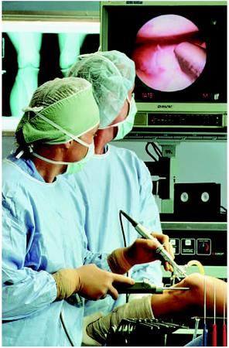
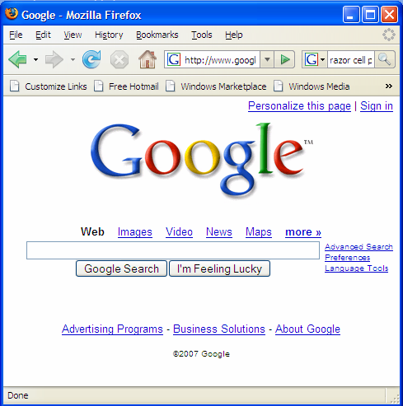
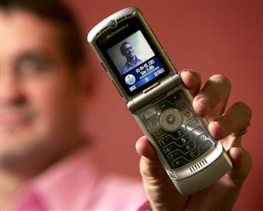
Background
Microprocessors have revolutionized our world
Cell phones, Internet, rapid advances in medicine, etc.
The semiconductor industry has grown from $21 billion in 1985 to $300 billion in 2011

Slide 5
Managing Complexity
Abstraction
Hiding details when they aren’t important.
Discipline
Act of intentionally restrict design choices
More productive
Example: digital discipline
The Three –Y’s
Hierarchy
A system divided into modules and submodules
Modularity
Having well-defined functions and interfaces
Regularity
Encouraging uniformity, so modules can be easily reused

Slide 6
Von Neumann Architecture
Stored Program
Instructions and data are logically the same and both stored in the same space (memory)
Components
CPU (Central Processing Unit)
Arithmetic/Logic Unit (ALU)
Control Unit (CU)
Registers
Program Counter (PC),
Instruction Register (IR)
Others: AC,MAR, MDR …
Memory
Input/Output devices

Slide 7
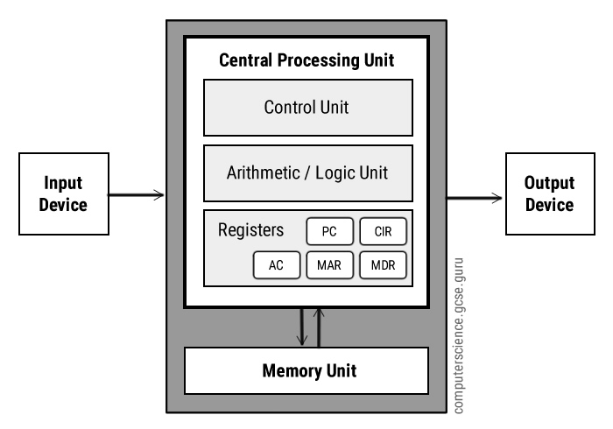
Von Neumann Architecture
Von Neumann Architecture
Level of abstraction for an electronic computing system

Slide 8
Von Neumann Architecture
Central Processing Unit (CPU)
The CPU is the electronic circuit responsible for executing the instructions of a computer program.
The CPU contains the ALU, CU and a variety of registers
Arithmetic/Logic Unit (ALU):
Arithmetic operations (add, subtract etc.) and logic operations (AND, OR, NOT etc.) operations are carried out
Control Unit (CU)
Controls the operation of the computer’s ALU, memory and input/output devices. Provides the timing and control signals required by other computer components
Registers
High speed storage areas in the CPU. All data must be stored in register before it can be processed

Slide 9
Von Neumann Architecture
Registers
MAR | Memory Address Register | Holds the memory location of data that needs to be accessed
MDR | Memory Data Register | Holds data that is being transferred to or from memory
AC | Accumulator | Where intermediate arithmetic and logic results are stored
PC | Program Counter | Contains the address of the next instruction to be executed
CIR(IR) | Current Instruction Register | Contains the current instruction during processing

Slide 10
Von Neumann Architecture
Buses
Buses are the means by which data is transmitted from one part of a computer to another, connecting all major internal components to the CPU and memory.
A standard CPU system bus is comprised of a control bus, data bus, and address bus
Address Bus | Carries the addresses of data (but not the data) between the processor and memory
Data Bus | Carries data between the processor, the memory unit and the input/output devices
Control Bus | Carries control signals/commands from the CPU (and status signals from other devices) in order to control and coordinate all the activities within the computer

Slide 11
Von Neumann Architecture
Memory Unit
The memory unit consists of RAM, sometimes referred to as primary or main memory. Unlike a hard drive (secondary memory), this memory is fast and also directly accessible by the CPU.
RAM is split into partitions. Each partition consists of an address and its contents (both in binary form).
The address will uniquely identify every location in the memory.
Loading data from permanent memory (hard drive), into the faster and directly accessible temporary memory (RAM), allows the CPU to operate much quicker

Slide 12
Von Neumann Architecture
Fetch-Execute Cycle
The fetch-execute cycle is the basic operation (instruction) cycle of a computer.
During the fetch execute cycle, the computer retrieves a program instruction from its memory. It then establishes and carries out the actions that are required for that instruction.
The cycle of fetching, decoding, and executing an instruction is continually repeated by the CPU whilst the computer is turned on.

Slide 13
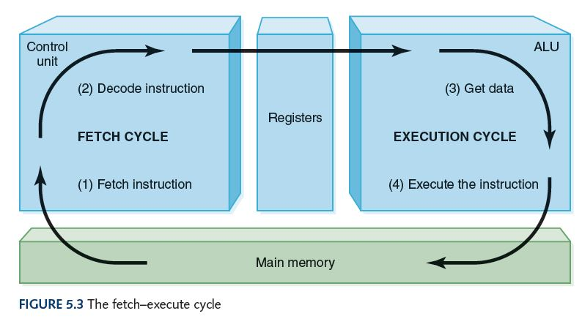
Fetch-Execute Cycle

Slide 14
Fetch-Execute Cycle
Stage | Description of Stage | Simplified Description
1 | The PC contains the address of the memory location that has the next instruction which has to be fetched | PC has address of next instruction
2 | This address is then copied from the PC to the MAR via the address bus | PC contents is copied to the MAR
3 | The contents (instruction) at the memory location (address) contained in MAR are then copied into the MDR | Lookup MAR and get contents. Copy contents into the MDR
4 | The contents (instruction) in the MDR is then copied and placed into the CIR | Copy MDR contents into the CIR
5 | The value in the PC is then incremented by 1 so that it now points to the next instruction which has to be fetched | PC is then incremented by 1
6 | The instruction is finally decoded and then executed by sending out signals (via control bus) to the various components of the computer | The instruction is decoded and then executed
7 | Repeat

Slide 15
Number Systems
Number System
Base and Symbols
Positional notation and Weight
Data Representation

Slide 16
Number Systems
Number System
Base and Symbols
Positional notation and Weight
Decimal
Base 10, Symbols (0, 1, 2, 3, 4, 5, 6, 7, 8, 9)
Binary
Base 2, Symbols (0, 1)
Hexadecimal
Base 16, Symbols (0, 1, 2, 3, 4, 5, 6, 7, 8, 9, A, B, C, D, E,F)
Octal decimal
Base 8, Symbols (0, 1, 2, 3, 4, 5, 6, 7)

Slide 17
Number Systems
Number System
Base and Symbols
Positional notation and Weight
642 in base 10 positional notation is:
6 x 10² = 6 x 100 = 600
+ 4 x 10¹ = 4 x 10 = 40
+ 2 x 10º = 2 x 1 = 2 = 642 in base 10
This number is in
base 10
The power indicates
the position of
the number

Slide 18
Number Systems
Number System
Base and Symbols
Positional notation and Weight
R is the base
of the number
General Formula:
d_{n-1} * R^{n-1} + d_{n-2} * R^{n-2} + ... + d₁ * R¹ + d₀ * R⁰
n is the number of
digits in the number
d is the digit in the
i^{th} position
in the number
642 is 6 * 10² + 4 * 10 ⁺ 2 * 1

Slide 19
Number Systems
Number System
Base and Symbols
Positional notation and Weight
What if 642 has the base of 13?
642 in base 13 is equivalent to 1068 in base 10
+ 6 x 13² = 6 x 169 = 1014
+ 4 x 13¹ = 4 x 13 = 52
+ 2 x 13º = 2 x 1 = 2
= 1068 in base 10

Slide 20
Number Systems
Values and Range
N-digit decimal number
How many values? 10^{N}
Range? [0, 10^{N} - 1]
Example: 3-digit decimal number:
N-bit binary number
How many values? 2^{N}
Range: [0, 2^{N} - 1]
Example: 3-digit binary number:

Slide 21
Number Systems
Values and Range
N-digit decimal number
How many values? 10^{N}
Range? [0, 10^{N} - 1]
Example: 3-digit decimal number:
10³ = 1000 possible values
Range: [0, 999]
N-bit binary number
How many values? 2^{N}
Range: [0, 2^{N} - 1]
Example: 3-digit binary number:
2³ = 8 possible values
Range: [0, 7] = [000₂ to 111₂]

Slide 22
Number Conversion
Binary to Decimal conversion
Convert 10011₂ to decimal
Decimal to Binary conversion:
Convert 47₁₀ to binary

Slide 23
Number Conversion
Binary to Decimal conversion
Convert 10011₂ to decimal
16×1 + 8×0 + 4×0 + 2×1 + 1×1 = 19₁₀
Decimal to Binary conversion:
Convert 47₁₀ to binary
32×1 + 16×0 + 8×1 + 4×1 + 2×1 + 1×1 = 101111₂

Slide 24
Number Conversion
Hexadecimal to Binary conversion
Convert 4AF₁₆ (also written 0x4AF) to binary
Hexadecimal to Decimal conversion:
Convert 0x4AF to decimal

Slide 25
Number Conversion
Hexadecimal to Binary conversion
Convert 4AF₁₆ (also written 0x4AF) to binary
0100 1010 1111₂
Hexadecimal to Decimal conversion:
Convert 0x4AF to decimal
4×16² + 10×16¹ + 15×16⁰ = 1199₁₀

Slide 26
Review: Bits, Bytes, Nibbles
Bits
Bytes & Nibbles
Bytes
Notes:
MSB: most significant bit/byte
LSB: least significant bit/byte

Slide 27
Review: Power of Two
2⁰ =
2¹ =
2² =
2³ =
2⁴ =
2⁵ =
2⁶ =
2⁷ =
2⁸ =
2⁹ =
2¹⁰ =
2¹¹ =
2¹² =
2¹³ =
2¹⁴ =
2¹⁵ =
2¹⁶ =
Notes:
Exercise

Slide 28
Review: Power of Two
2⁰ = 1
2¹ = 2
2² = 4
2³ = 8
2⁴ = 16
2⁵ = 32
2⁶ = 64
2⁷ = 128
2⁸ = 256
2⁹ = 512
2¹⁰ = 1024
2¹¹ = 2048
2¹² = 4096
2¹³ = 8192
2¹⁴ = 16384
2¹⁵ = 32768
2¹⁶ = 65536
Notes:
Exercise

Slide 29
Review: Large Powers of Two
2¹⁰ = 1 kilo ≈ 1000 (1024)
2²⁰ = 1 mega ≈ 1 million (1,048,576)
2³⁰ = 1 giga ≈ 1 billion (1,073,741,824)
2⁴⁰ = 1 tera ≈ ?
2⁵⁰ = …
…
Notes:
MSB: most significant bit/byte
LSB: least significant bit/byte

Slide 30
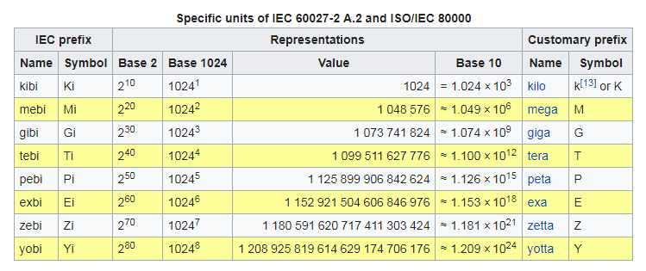
Review: Large Powers of Two
Notes:
MSB: most significant bit/byte
LSB: least significant bit/byte

Slide 31
Exercise: estimate powers of two
What is the value of 2²⁴?
How many values can a 32-bit variable represent?
Notes:
MSB: most significant bit/byte
LSB: least significant bit/byte

Slide 32
Exercise: estimate powers of two
What is the value of 2²⁴?
2⁴ × 2²⁰ ≈ 16 million
How many values can a 32-bit variable represent?
2² × 2³⁰ ≈ 4 billion
Notes:
Exercise

Slide 33
Addition
Decimal addition
Binary addition
Hexadecimal
1 1 carries
12A6
+ 07CD
1A93
Notes:
Exercise

Slide 34
Exercise: Addition
Add the following 4-bit binary numbers:
1001 1011
+ 0101 + 0110
Add the following 4-bit hexadecimal numbers:
10A6 906A
+ 07CD + 70DC
Notes:
Exercise

Slide 35
Overflow
Digital systems operate on a fixed number of bits
Overflow: when result is too big to fit in the available number of bits
How to handle overflow ?
Notes:
Exercise

Slide 36
Signed Binary Numbers
Sign/Magnitude Numbers
Two’s Complement Numbers
Notes:
Exercise

Slide 37
Signed Binary Numbers
Sign/Magnitude Numbers
1 sign bit, N-1 magnitude bits
Sign bit is the most significant (left-most) bit
Positive number: sign bit = 0
Negative number: sign bit = 1
Q: 4-bit sign/magnitude representations of ± 6:
+6 = ?
- 6 = ?
Q: Range of an N-bit sign/magnitude number:
?
Notes:
Exercise

Slide 38
Signed Binary Numbers
Sign/Magnitude Numbers
1 sign bit, N-1 magnitude bits
Sign bit is the most significant (left-most) bit
Positive number: sign bit = 0
Negative number: sign bit = 1
Q: 4-bit sign/mag representations of ± 6:
+6 = 0110
- 6 = 1110
Q: Range of an N-bit sign/magnitude number:
[-(2^{N-1}-1), 2^{N-1}-1]
Notes:
Exercise

Slide 39
Signed Binary Numbers
Sign/Magnitude Numbers
Problems:
Addition doesn’t work, for example -6 + 6:
1110
+ 0110
10100 (wrong!)
Two representations of 0 (±0):
1000
0000
Notes:
Exercise

Slide 40
Signed Binary Numbers
Two’s Complement Numbers
Don’t have same problems as sign/magnitude numbers:
Addition works
Single representation for 0
Msb has value of -2^{N-1}
Most positive 4-bit number:
Most negative 4-bit number:
The most significant bit still indicates the sign:
1 = negative, 0 = positive
Range of an N-bit two’s comp number:
Notes:
Exercise

Slide 41
Signed Binary Numbers
Two’s Complement Numbers
Don’t have same problems as sign/magnitude numbers:
Addition works
Single representation for 0
Msb has value of -2^{N-1}
Most positive 4-bit number: 0111
Most negative 4-bit number: 1000
The most significant bit still indicates the sign:
1 = negative, 0 = positive
Range of an N-bit two’s comp number: [-(2^{N-1}), 2^{N-1}-1]
Notes:
Exercise

Slide 42
Signed Binary Numbers
Two’s Complement Numbers
“Taking the Two’s Complement
Flip the sign of a two’s complement number
Method:
Invert the bits
Add 1
Example 1: Flip the sign of 3₁₀ = 0011₂
Notes:
Exercise

Slide 43
Signed Binary Numbers
Two’s Complement Numbers
“Taking the Two’s Complement
Flip the sign of a two’s complement number
Method:
Invert the bits
Add 1
Example 1: Flip the sign of 3₁₀ = 0011₂
1100
+ 1
1101 = -3₁₀
Notes:
Exercise

Slide 44
Signed Binary Numbers
Two’s Complement Numbers
Example 2: Take the two’s complement of 6₁₀ = 0110₂
Example 3: What is the decimal value of 1001₂?
Notes:
Exercise

Slide 45
Signed Binary Numbers
Two’s Complement Numbers
Example 2: Take the two’s complement of 6₁₀ = 0110₂
1001
+ 1
1010₂ = -6₁₀
Example 3: What is the decimal value of 1001₂?
0110
+ 1
0111₂ = 7₁₀, so 1001₂ = -7₁₀
Notes:
Exercise

Slide 46
Signed Binary Numbers
Two’s Complement Numbers
Addition
Add 6 + (-6) using two’s complement numbers
Add -2 + 3 using two’s complement numbers
Notes:
Exercise

Slide 47
Signed Binary Numbers
Two’s Complement Numbers
Addition
Add 6 + (-6) using two’s complement numbers
Add -2 + 3 using two’s complement numbers
Notes:
Exercise

Slide 48
Signed Binary Numbers
Two’s Complement Numbers
Extend number from N to M bits (M > N) :
Sign-extension
Zero-extension
Notes:
Exercise

Slide 49
Signed Binary Numbers
Two’s Complement Numbers
Extend number from N to M bits (M > N) :
Sign-extension
Zero-extension
Sign bit copied to msb’s
Number value is the same
Example 1:
4-bit representation of 3 = 0011
8-bit sign-extended value: 00000011
Example 2:
4-bit representation of -5 = 1011
8-bit sign-extended value: 11111011
Notes:
Exercise

Slide 50
Signed Binary Numbers
Two’s Complement Numbers
Extend number from N to M bits (M > N) :
Sign-extension
Zero-extension
Zeros copied to msb’s
Value changes for negative numbers
Example 1:
4-bit value = 0011₂ = 3₁₀
8-bit zero-extended value: 00000011 = 3₁₀
Example 2:
4-bit value = 1011 = -5₁₀
8-bit zero-extended value: 00001011 = 11₁₀
Notes:
Exercise

Slide 51
Number System Comparison
Number System | Range
Unsigned | [0, 2^{N}-1]
Sign/Magnitude | [-(2^{N-1}-1), 2^{N-1}-1]
Two’s Complement | [-2^{N-1}, 2^{N-1}-1]
For example, 4-bit representation:
Notes:
Exercise

